Slide 1
Performance Tuning and Auto-Scaling Setup

Slide 2
Relational Database Service(RDS):-
Amazon Relational Database Service (RDS) makes it easy to set up, operate and scale a relational database in the cloud.
A relational database (RDB) is a type of database that organizes data into tables, rows, and columns to establish relationships between data points
The relational model is a standard way of representing and querying data
Database:-
A database is an electronically stored, systematic collection of data. It can contain any type of data, including words, numbers, images, videos, and files. You can use software called a database management system (DBMS) to store, retrieve, and edit data.
AWS DataBase:
Aws Database is a collection of databases that offer a high-performance, secure, and reliable foundation for data-driven applications and generative AI solutions

Slide 3
Creating RDS Database through terraform
First create a folder on desktop and name it as per your requirement
Open the folder in VS Code to create rds instances
Create a file with the name main.tf (A main.tf file is a core component in Terraform configurations, where you define the infrastructure resources you want to create, modify, or delete in your cloud environment)
Here we need to create the different types of files for infrastructure resources you want to create like
Ec2.tf (to create the ec2 instance)
Public.tf (it is used to define public-facing resources or resources that require external access, such as public IP addresses, security groups, and load balancers)
Private.tf (it is used to define resources or settings that are meant to be private or internal to your infrastructure)

Slide 4
Provider.tf (It is a file where you define the provider configurations that Terraform uses to interact with different cloud platforms or services)
Variables.tf (Variables allow you to make your Terraform scripts more flexible and reusable, as they allow you to pass in different values (e.g., for regions, instance types, and other configurations)
Outputs.tf (Terraform is used to define output values that are displayed to the user after Terraform applies or updates the infrastructure)
Rds.tf (Terraform is used to define resources related to Amazon RDS (Relational Database Service). In this file, you can create RDS instances, security groups, and related resources like parameter groups, subnet groups, and option groups)
Dev.tfvars (this file is typically used in development environments to provide specific values for the Terraform variables)

Slide 5
Main.tf
resource "aws_vpc" "amc-vpc" {
tags = merge(var.tags, {})
cidr_block = var.vpc_cidr
enable_dns_hostnames = true
enable_dns_support = true
}
Ec2.tf:-
data "aws_ami" "ubuntu" {
most_recent = true
filter {
name = "name"
values = ["ubuntu/images/hvm-ssd/ubuntu-jammy-22.04-amd64-server-*"]
}

Slide 6
filter {
name = "virtualization-type"
values = ["hvm"]
}
owners = ["099720109477"] # Canonical
}
resource "aws_instance" "server" {
ami = data.aws_ami.ubuntu.id
instance_type = "t2.micro"
subnet_id = aws_subnet.public_a.id
associate_public_ip_address = true
security_groups = [aws_security_group.ec2_sg.id]
tags = {
Name = "RDS_INSTANCE"
}
}

Slide 7
resource "aws_security_group" "ec2_sg" {
name = "Allow Database"
description = "Allow Database inbound traffic and all outbound traffic"
vpc_id = aws_vpc.amc-vpc.id
tags = {
Name = "allow_tls"
}
}
resource "aws_vpc_security_group_ingress_rule" "ec2_sg_ig1" {
security_group_id = aws_security_group.ec2_sg.id
cidr_ipv4 = "0.0.0.0/0"
ip_protocol = "tcp"
from_port = 0
to_port = 65535
}

Slide 8
resource "aws_vpc_security_group_egress_rule" "ec2_sg_eg1" {
security_group_id = aws_security_group.ec2_sg.id
cidr_ipv4 = "0.0.0.0/0"
from_port = 0
ip_protocol = "tcp"
to_port = 65535
}
Public.tf
resource "aws_internet_gateway" "amc-vpc-igw" {
vpc_id = aws_vpc.amc-vpc.id
tags = merge(var.tags, {})
}

Slide 9
resource "aws_subnet" "public_b" {
vpc_id = aws_vpc.amc-vpc.id
tags = merge(var.tags, {})
cidr_block = var.subnets.b
availability_zone = "us-east-1a"
}
resource "aws_subnet" "public_a" {
vpc_id = aws_vpc.amc-vpc.id
tags = merge(var.tags, {})
cidr_block = var.subnets.a
availability_zone = "us-east-1a"
}

Slide 10
resource "aws_eip" "eip_b" {
tags = merge(var.tags, {})
}
resource "aws_eip" "eip_a" {
tags = merge(var.tags, {})
}
resource "aws_nat_gateway" "nat-gw-2a-public" {
allocation_id = aws_eip.eip_a.id
subnet_id = aws_subnet.public_a.id
tags = merge(var.tags, {})
depends_on = [aws_eip.eip_a]
}

Slide 11
resource "aws_nat_gateway" "nat-gw-2b-public" {
allocation_id = aws_eip.eip_b.id
subnet_id = aws_subnet.public_b.id
tags = merge(var.tags, {})
depends_on = [aws_eip.eip_b]
}
resource "aws_route_table" "rt_public_a" {
vpc_id = aws_vpc.amc-vpc.id
}
resource "aws_route_table_association" "rt_assoc_public_a" {
subnet_id = aws_subnet.public_a.id
route_table_id = aws_route_table.rt_public_a.id
}

Slide 12
resource "aws_route" "route_a" {
route_table_id = aws_route_table.rt_public_a.id
destination_cidr_block = "0.0.0.0/0"
gateway_id = aws_internet_gateway.amc-vpc-igw.id
}
resource "aws_route_table" "rt_public_b" {
vpc_id = aws_vpc.amc-vpc.id
tags = merge(var.tags, {})
}
resource "aws_route_table_association" "rt_assoc_public_b" {
subnet_id = aws_subnet.public_b.id
route_table_id = aws_route_table.rt_public_b.id
}

Slide 13
resource "aws_route" "route_b" {
route_table_id = aws_route_table.rt_public_b.id
destination_cidr_block = "0.0.0.0/0"
gateway_id = aws_internet_gateway.amc-vpc-igw.id
}
Private.tf
resource "aws_route_table" "rt_private_a" {
vpc_id = aws_vpc.amc-vpc.id
tags = merge(var.tags, {})
}
resource "aws_route_table_association" "rt_assoc_private_a" {
subnet_id = aws_subnet.private_a.id
route_table_id = aws_route_table.rt_private_a.id
}

Slide 14
resource "aws_route" "route_pa" {
route_table_id = aws_route_table.rt_private_a.id
destination_cidr_block = "0.0.0.0/0"
nat_gateway_id = aws_nat_gateway.nat-gw-2a-public.id
}
resource "aws_route_table" "rt_private_b" {
vpc_id = aws_vpc.amc-vpc.id
tags = merge(var.tags, {})
}
resource "aws_route_table_association" "rt_assoc_private_b" {
subnet_id = aws_subnet.private_b.id
route_table_id = aws_route_table.rt_private_b.id
}

Slide 15
resource "aws_route" "route_pb" {
route_table_id = aws_route_table.rt_private_b.id
destination_cidr_block = "0.0.0.0/0"
nat_gateway_id = aws_nat_gateway.nat-gw-2b-public.id
}
resource "aws_subnet" "private_a" {
vpc_id = aws_vpc.amc-vpc.id
tags = merge(var.tags, {})
map_public_ip_on_launch = false
cidr_block = var.private_subnets.a
availability_zone = "us-east-1a"
}
resource "aws_subnet" "private_b" {
vpc_id = aws_vpc.amc-vpc.id
tags = merge(var.tags, {})
map_public_ip_on_launch = false
cidr_block = var.private_subnets.b
availability_zone = "us-east-1b"
}

Slide 16
Provider.tf
terraform {
required_providers {
aws = {
version = "= 5.33.0"
}
}
}
provider "aws" {
region = "us-east-1"
}
Variables.tf
variable "private_subnets" {
type = map(any)
default = {
a = "10.0.4.0/24"
b = "10.0.5.0/24"
}
}

Slide 17
variable "subnets" {
description = "Default values for public subnets."
type = map(any)
default = {
a = "10.0.1.0/24"
b = "10.0.2.0/24"
}
}
variable "tags" {
description = "Default tags to apply to all resources."
type = map(any)
}
variable "vpc_cidr" {
description = "The network addressing for the default VPC."
type = string
default = "10.0.0.0/16"
}
variable "amount_limitation" {
type = number
default = 1000
}
variable "db_password" {
description = "The password of the database"
type = string
default = "Kinnera03#"
sensitive = true
}
variable "db_password_imported" {
description = "The password of the database"
type = string
default = "Kinnera03#"
sensitive = true
}

Slide 18
variable "db_port" {
type = string
default = "5432"
}
variable "db_port_imported" {
type = string
default = "5432"
sensitive = true
}
variable "ec2_amount_limitation" {
type = number
default = 500
}
variable "ec2_threshold" {
type = number
default = 400
}
variable "email" {
type = string
default = "kinnerasunildev@gmail.com"
}
variable "instance_class" {
description = "The instance class for the RDS DB instance"
type = string
default = "db.t3.micro"
}

Slide 19
variable "instance_class_imported" {
type = string
default = "db.t3.micro"
}
variable "s3_amount" {
type = number
default = 100
}
variable "threshold" {
type = number
default = 800
}

Slide 20
Outputs.tf
Dev.tfvars
output "default_rds_hostname" {
description = "The hostname of the default DB"
sensitive = true
value = aws_db_instance.db1.address
}
tags = {
Environment = "Development"
Project = "AWS RDS"
Owner = "Sunil Dev"
}
db_password = "Kinnera03#"

Slide 21
Rds.tf
resource "aws_db_subnet_group" "default" {
name = "default_subnet_group"
description = "The default subnet group for all DBs in this architecture"
subnet_ids = [
aws_subnet.private_a.id,
aws_subnet.private_b.id,
]
tags = {
env = "Dev"
}
}
resource "aws_db_parameter_group" "log_db_parameter" {
name = "logs"
family = "MySQL8.0"
parameter {
value = "1"
name = "log_connections"
}
tags = {
env = "Dev"
}
}

Slide 22
resource "aws_db_instance" "db1" {
username = "sunildev"
skip_final_snapshot = true
publicly_accessible = true
password = var.db_password
parameter_group_name = aws_db_parameter_group.log_db_parameter.name
instance_class = var.instance_class
engine_version = "16.1"
db_name = "amc"
engine = "MySQL"
db_subnet_group_name = aws_db_subnet_group.default.name
backup_retention_period = 1
allocated_storage = 50
multi_az = true
tags = {
env = "Dev"
}

Slide 23
vpc_security_group_ids = [
aws_security_group.sg.id
]
}
resource "aws_security_group" "sg" {
name = "db_sg"
description = "Default sg for the database"
vpc_id = aws_vpc.amc-vpc.id
tags = {
Name = "db_sg"
}
}
resource "aws_vpc_security_group_ingress_rule" "allow_tls_ipv4" {
security_group_id = aws_security_group.sg.id
referenced_security_group_id = aws_security_group.ec2_sg.id
from_port = 5432
ip_protocol = "tcp"
to_port = 5432
}

Slide 24
resource "aws_vpc_security_group_egress_rule" "allow_tls_eg" {
security_group_id = aws_security_group.ec2_sg.id
referenced_security_group_id = aws_security_group.ec2_sg.id
from_port = 0
ip_protocol = "tcp"
to_port = 65535
}
resource "aws_db_instance" "db_replica" {
skip_final_snapshot = true
replicate_source_db = aws_db_instance.db1.identifier
publicly_accessible = true
parameter_group_name = aws_db_parameter_group.log_db_parameter.name
instance_class = var.instance_class
identifier = "db-replica"
backup_retention_period = 7
apply_immediately = true

Slide 25
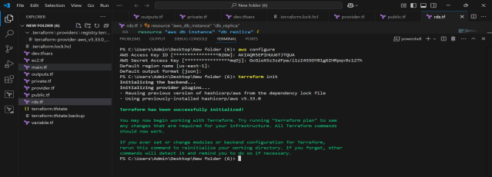
tags = {
replica = "true"
env = "Dev"
}
vpc_security_group_ids = [
aws_security_group.sg.id,
]
}
Now add the security credentials from AWS account in VS Code (Access Key & Security code).
Now enter Terraform init to initialize the code

Slide 26
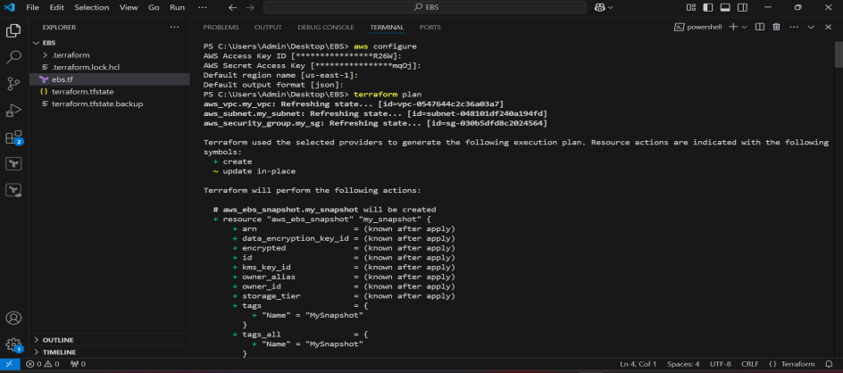
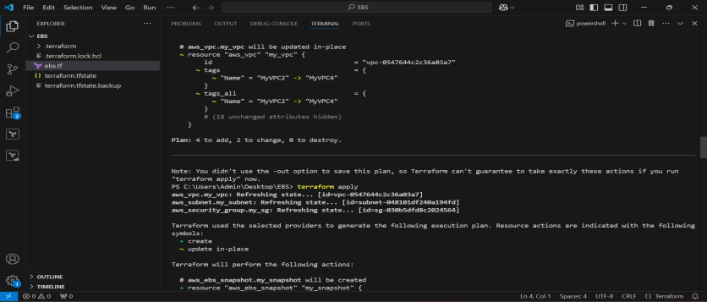
After initializing only all the terraform commands will start working
Now enter terraform plan -var-file="dev.tfvars“ to see the change that are required for the code
Now we can see how many changes are added to the code in below

Slide 27
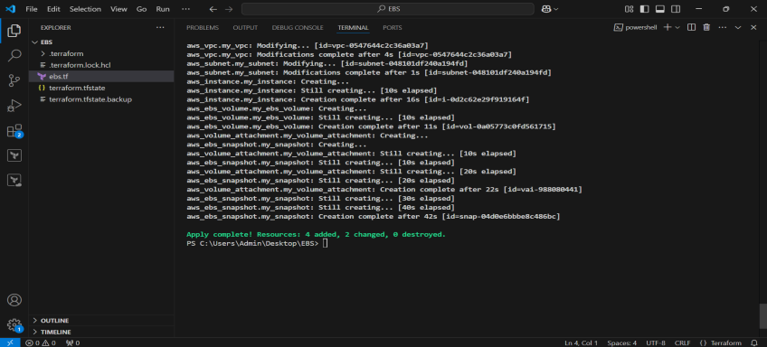
Now enter the terraform apply -var-file="dev.tfvars“ command in Terraform is used to apply the changes defined in your Terraform configuration files to your infrastructure.
Enter the value as YES to accept the changes in the code
Now you can see how many resources are to the code after applying the terraform plan
Now check weather the Instances, Rds Database and vpc’s are created or not with the code

Slide 28
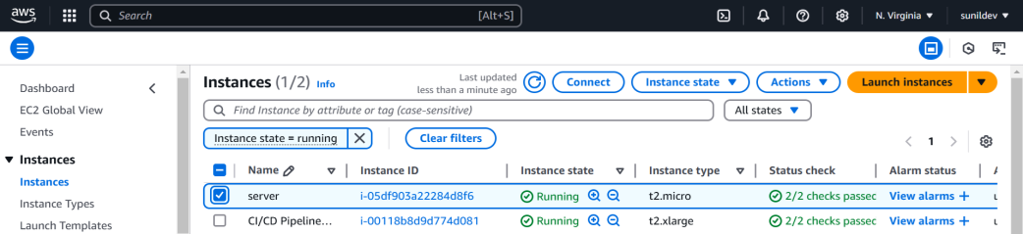
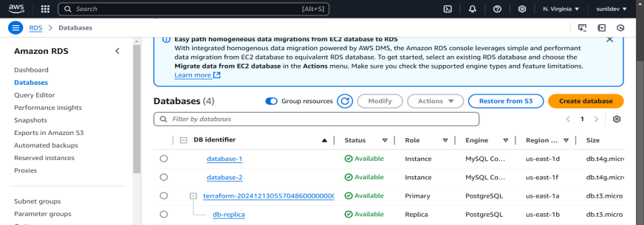
Here instance is created with the name of server
Rds Is created with the name of Terraform given in the code and replica is also created successfully

Slide 29
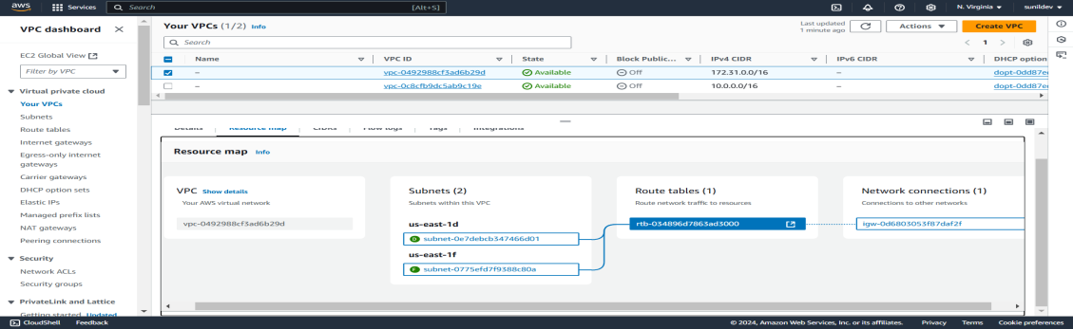
Below are the vpc’s created with the terraform code given in vs-code
Now connect the instance with ec2 instance connect and install the postgresql and connect it with the ec2 machine
sudo apt-get install -y postgresql
psql (enter the end point of the rds instance here) --username=awsuser --password --dbname=amc

Slide 30
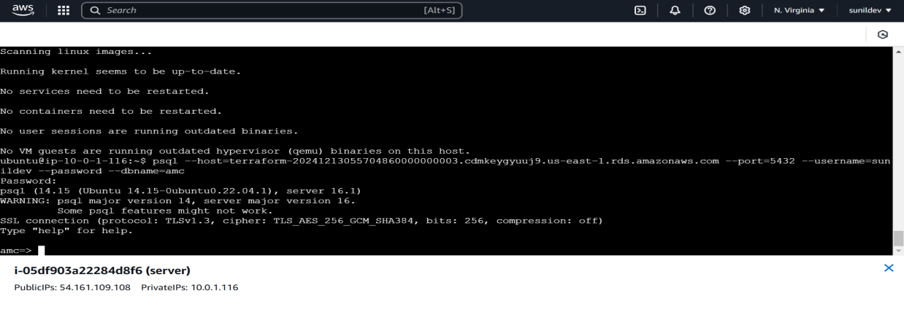
Enter the endpoint and give the dbname as you given in the code press enter and below is the result

Slide 31
AutoScaling:
Auto Scaling is a cloud computing feature that automatically adjusts the number of resources (e.g., virtual machines, containers, or instances) in a system based on the load or demand. It ensures that your application has the right amount of compute resources at any given time, helping to maintain performance while optimizing costs.
In the context of Amazon Web Services (AWS), Auto Scaling can be applied to various services, including EC2 instances, ECS tasks, and Lambda functions.
Auto-scaling is a scaling technique you can apply to workloads hosted in a cloud environment. One of the major benefits of cloud-based hosting is that you can readily scale capacity to whatever extent is needed to support the demand for your service. Auto-scaling takes that advantage a step further.

Slide 32
How to create Auto scaling using Terraform:-
Create an Autoscaling folder on desktop
Now open the VS code and open the new folder (Autoscaling Folder)
Create required files in the folder to enter the terraform code
Main.tf
Provider.tf
Routetable.tf
Subnet.tf
Securitygroup.tf
Terraform.tf
Vpc.tf

Slide 33
Main.tf
resource "aws_security_group" "web_server-03" {
name = "web-server-sg"
description = "Allow HTTP and SSH traffic"
vpc_id = aws_vpc.main.id
ingress {
from_port = 80
to_port = 80
protocol = "tcp"
cidr_blocks = ["0.0.0.0/0"]
}
ingress {
from_port = 22
to_port = 22
protocol = "tcp"
cidr_blocks = ["0.0.0.0/0"]
}
egress {
from_port = 0
to_port = 0
protocol = "-1"
cidr_blocks = ["0.0.0.0/0"]
}
tags = {
Name = "web-server-sg"
}
}
# Launch Template
resource "aws_launch_template" "web_server-03" {
name = "web-server-launch-template"
image_id = "ami-05576a079321f21f8"
instance_type = "t2.micro"
user_data = base64encode(<<-EOF

Slide 34
#!/bin/bash
sudo apt-get update -y
sudo apt-get install apache2 -y
sudo systemctl start apache2
sudo systemctl enable apache2
echo "<html><body><h1>Welcome to Terraform Scaling.</h1></body></html>" > /var/www/html/index.html
EOF
) network_interfaces {
security_groups = [aws_security_group.web_server.id]
} tag_specifications {
resource_type = "instance"
tags = {
Name = "WebServerInstance"
}
}
}
# Elastic Load Balancer
resource "aws_elb" "web_server_lb" {
name = "web-server-lb-03"
security_groups = [aws_security_group.web_server.id]
subnets = [aws_subnet.public_subnet.id] # Use public subnets only listener {
instance_port = 80
instance_protocol = "HTTP"
lb_port = 80
lb_protocol = "HTTP"
} health_check {
target = "HTTP:80/"
interval = 30
timeout = 5
healthy_threshold = 2
unhealthy_threshold = 2
}

Slide 35
tags = {
Name = "terraform-elb-03"
}
}
resource "aws_autoscaling_group" "web_server_asg" {
name = "web-server-asg-03"
desired_capacity = 2
max_size = 3
min_size = 1
vpc_zone_identifier = [aws_subnet.public_subnet.id] # Ensure this subnet is public
launch_template {
id = aws_launch_template.web_server-03.id # Correct reference to the launch template
version = "$Latest"
}
health_check_type = "EC2"
load_balancers = [aws_elb.web_server_lb.name]
tag {
key = "Microservice--03"
value = "web-server-as-03"
propagate_at_launch = true
}
}

Slide 36
Provider.tf
provider "aws" {
region = "us-east-1"
}
Routetable.tf
# Public Route Table
resource "aws_route_table" "public" {
vpc_id = aws_vpc.main.id
# Add route for internet traffic
route {
cidr_block = "0.0.0.0/0"
gateway_id = aws_internet_gateway.my_igw.id
}

Slide 37
tags = {
Name = "PublicRouteTable"
}
}
# Associate the Route Table with the Public Subnet
resource "aws_route_table_association" "public_subnet" {
subnet_id = aws_subnet.public_subnet.id
route_table_id = aws_route_table.public.id
}

Slide 38
Securitygroup.tf
resource "aws_security_group" "web_server" {
name_prefix = "web-server-sg"
vpc_id = aws_vpc.main.id
ingress {
from_port = 80
to_port = 80
protocol = "tcp"
cidr_blocks = ["0.0.0.0/0"]
}
ingress {
from_port = 22
to_port = 22
protocol = "tcp"
cidr_blocks = ["0.0.0.0/0"]
}

Slide 39
egress {
from_port = 0
to_port = 0
protocol = -1
cidr_blocks = ["0.0.0.0/0"]
}
}
Subnet.tf
resource "aws_internet_gateway" "my_igw" {
vpc_id = aws_vpc.main.id
tags = {
Name = "internet-gateway-03"
}
}

Slide 40
# Public Subnet
resource "aws_subnet" "public_subnet" {
vpc_id = aws_vpc.main.id
cidr_block = "10.0.1.0/24"
availability_zone = "us-east-1a"
map_public_ip_on_launch = true
tags = {
Name = "PublicSubnet"
}
}
# Private Subnet
resource "aws_subnet" "private_subnet" {
vpc_id = aws_vpc.main.id
cidr_block = "10.0.2.0/24"
availability_zone = "us-east-1b"

Slide 41
tags = {
Name = "PrivateSubnet"
}
}
resource "aws_elb" "web_server_lb-03" {
name = "web-server-lb"
subnets = [aws_subnet.public_subnet.id, aws_subnet.private_subnet.id]
listener {
instance_port = 80
instance_protocol = "HTTP"
lb_port = 80
lb_protocol = "HTTP"
}

Slide 42
health_check {
target = "HTTP:80/"
interval = 30
timeout = 5
healthy_threshold = 2
unhealthy_threshold = 2
}
tags = {
Name = "WebServerLB"
}
}
resource "aws_route_table_association" "public_subnet-03" {
subnet_id = aws_subnet.public_subnet.id
route_table_id = aws_route_table.public.id
}

Slide 43
Terraform.tf
terraform {
required_providers {
aws = {
source = "hashicorp/aws"
version = "~> 4.0"
}
}
}
Vpc.tf
resource "aws_vpc" "main" {
cidr_block = "10.0.0.0/16"
tags = {
Name = "main"
}
}

Slide 44
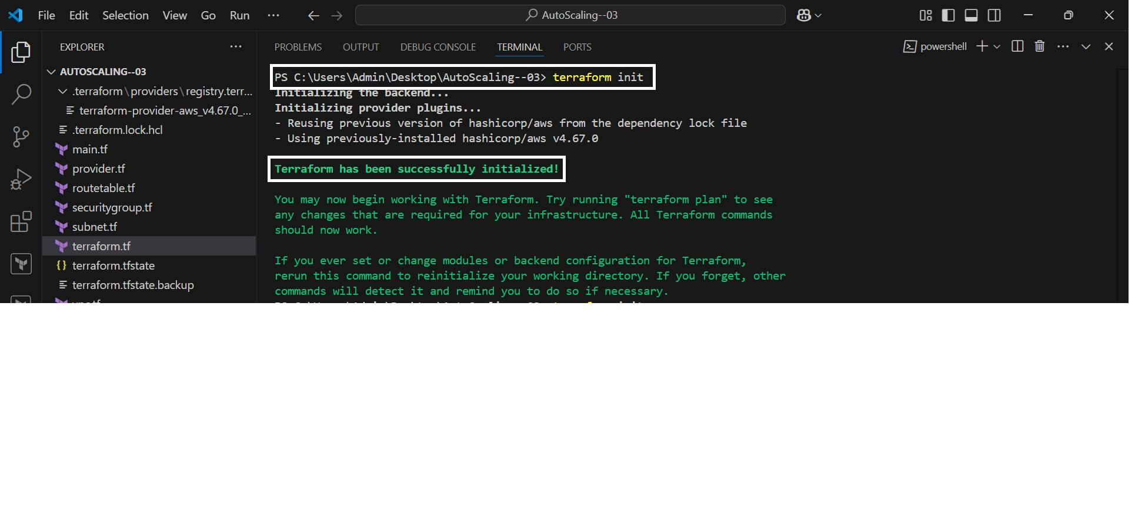
Now copy the security credentials from aws console and configure the vscode “Aws Configure”
Enter the required details like Access Key ID and Password
Enter the required region (ex “us-east-1”)
Enter the format of the code “Json”
Now initialize the code with the command “terraform init”

Slide 45
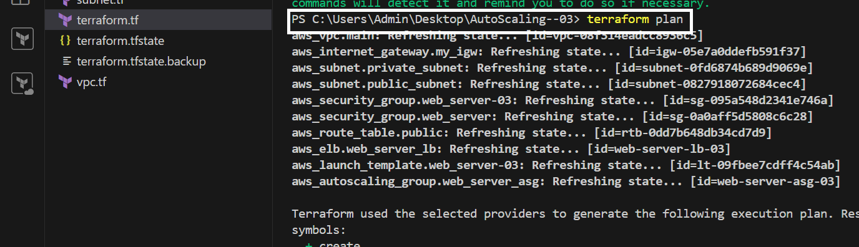
After initialization now enter the command “terraform plan” creates an execution plan, which lets you preview the changes that Terraform plans to make to your infrastructure
All the Vpc’s, routetables, subnets and internet gateways are get created after applying the plan command
We can check this changes in aws console weather the vpc, subnets…etc are created or not
Ec2 instance will be created after successfully applying the terraform plan command

Slide 46
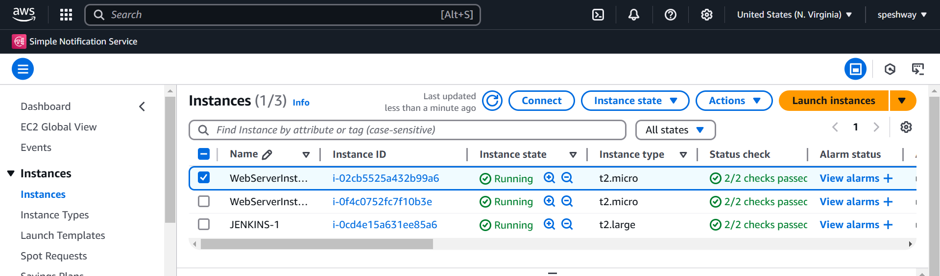
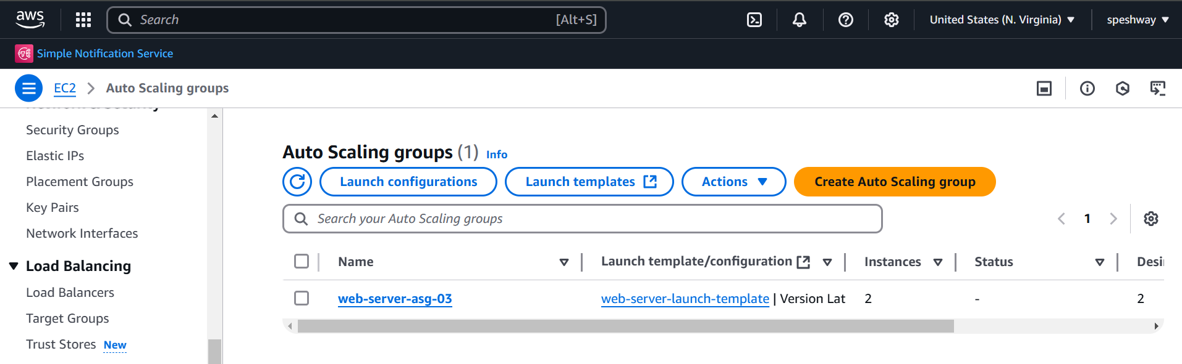

Slide 47
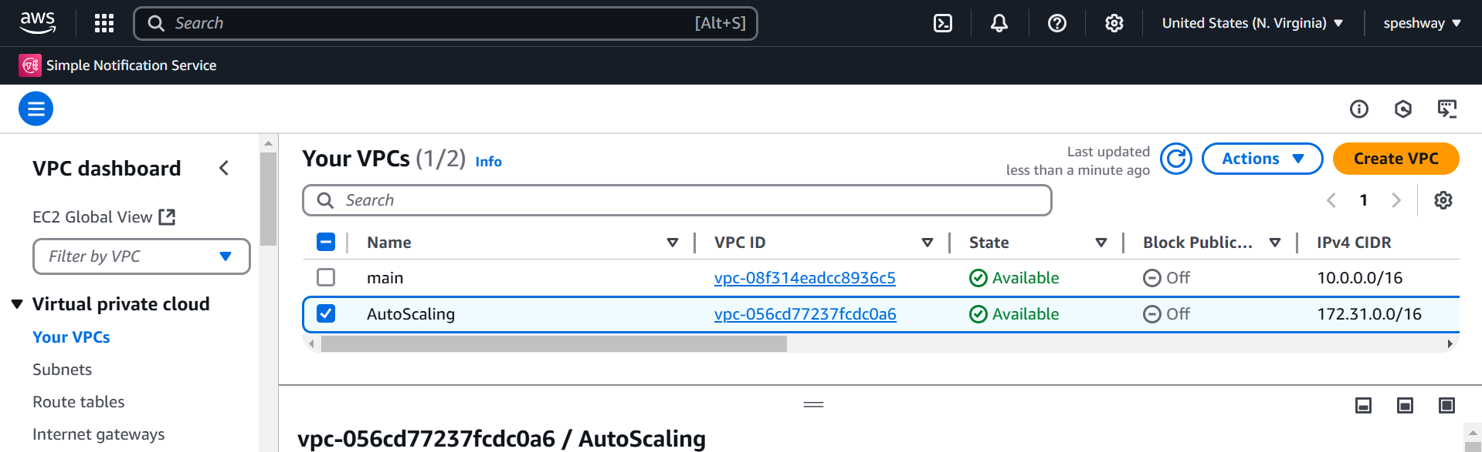
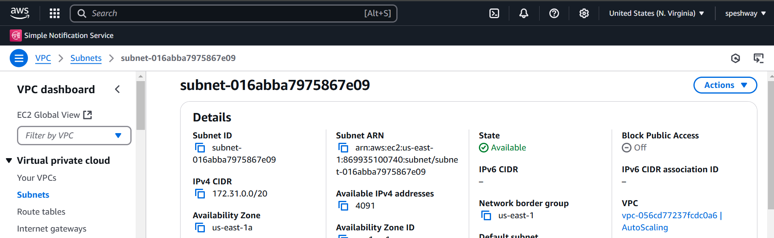

Slide 48
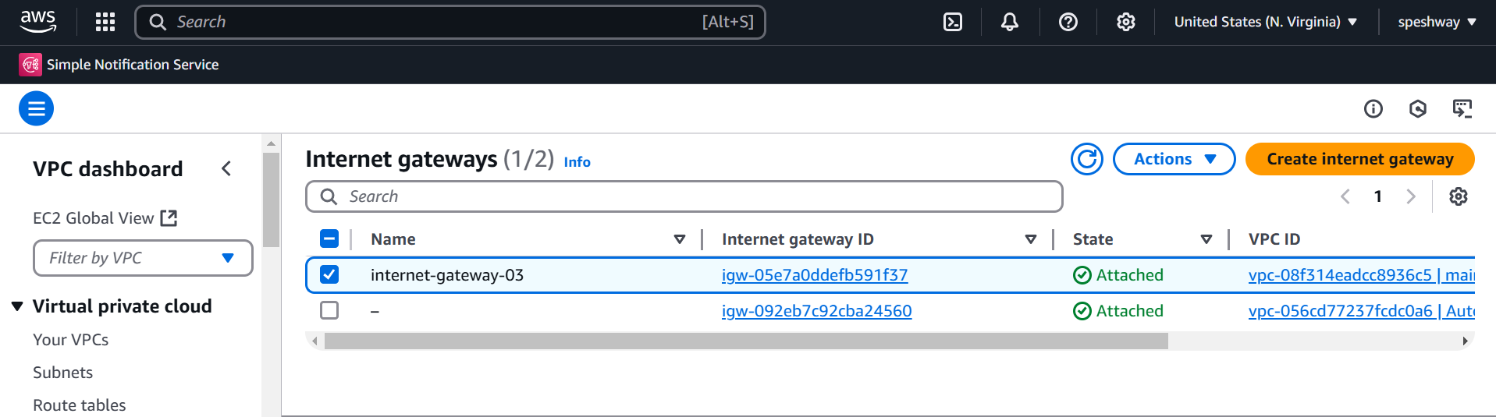
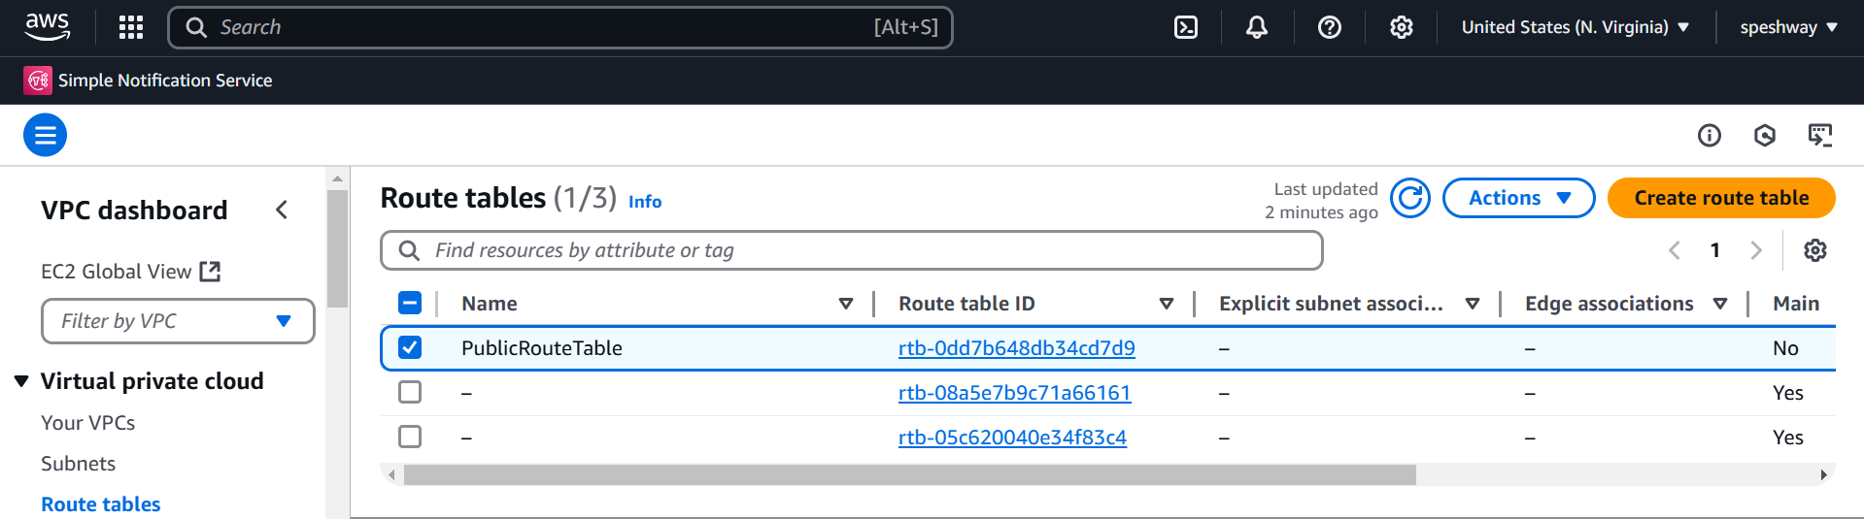

Slide 49
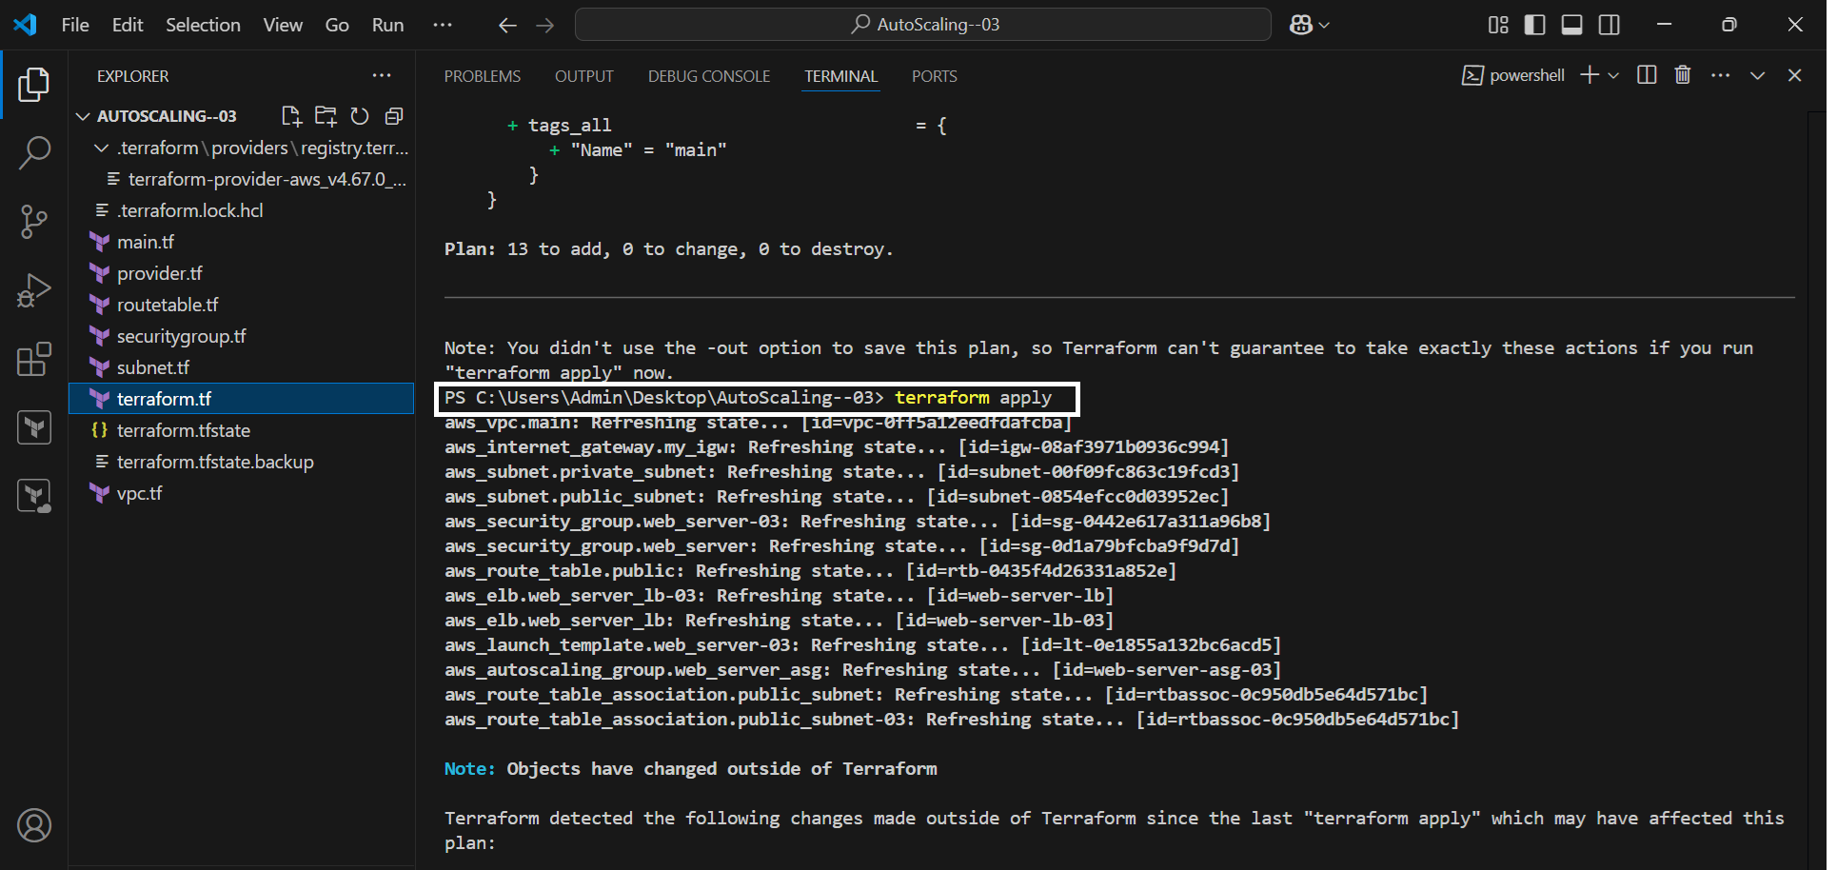
After successfully creating all the required infrastructure now apply the “terraform apply” for executes planned actions, creating, updating, or deleting infrastructure resources to match the new state outlined in your IaC
These are the steps to create the autoscaling using the terraform

Slide 50
Deploying Ngnix Image using ECS
Amazon Elastic Container Service (ECS) is a cloud computing service that helps users manage and deploy containerized applications on Amazon Web Services (AWS).
Ecs helps you to more efficiently deploy, manage, and scale containerized applications.
An AWS load balancer is a service that distributes incoming traffic from clients to multiple targets, such as EC2 instances or containers.
A load balancer serves as the single point of contact for clients.
Load balancers improve application performance by increasing response time and reducing network latency.

Slide 51
Terraform code to create ecs in Vscode
Ecs.tf
provider "aws" {
region = "us-east-1"
}
# ECS Cluster
resource "aws_ecs_cluster" "nginx_cluster" {
name = "nginx-cluster-03"
}
# ECS Task Definition
resource "aws_ecs_task_definition" "nginx_task" {
family = "nginx-task"
requires_compatibilities = ["FARGATE"]
network_mode = "awsvpc"
cpu = "256"

Slide 52
memory = "512"
container_definitions = jsonencode([{
name = "nginx-container-03"
image = "nginx:latest"
cpu = 256
memory = 512
essential = true
portMappings = [{
containerPort = 80
hostPort = 80
protocol = "tcp"
}]
}])
}
# Application Load Balancer
resource "aws_lb" "nginx_alb" {
name = "nginx-alb"

Slide 53
internal = false
load_balancer_type = "application"
security_groups = [aws_security_group.nginx_sg.id]
subnets = aws_subnet.public_subnets[*].id
tags = {
Name = "nginx-alb"
}
}
# Target Group
resource "aws_lb_target_group" "nginx_tg" {
name = "nginx-target-group"
port = 80
protocol = "HTTP"
vpc_id = aws_vpc.main.id
target_type = "ip"

Slide 54
health_check {
path = "/"
interval = 30
timeout = 5
healthy_threshold = 3
unhealthy_threshold = 2
}
tags = {
Name = "nginx-target-group"
}
}
# ALB Listener
resource "aws_lb_listener" "nginx_listener" {
load_balancer_arn = aws_lb.nginx_alb.arn
port = 80
protocol = "HTTP"

Slide 55
default_action {
type = "forward"
target_group_arn = aws_lb_target_group.nginx_tg.arn
}
}
# ECS Service
resource "aws_ecs_service" "nginx_service" {
name = "nginx-service-03"
cluster = aws_ecs_cluster.nginx_cluster.id
task_definition = aws_ecs_task_definition.nginx_task.arn
launch_type = "FARGATE"
network_configuration {
subnets = aws_subnet.public_subnets[*].id
security_groups = [aws_security_group.nginx_sg.id]
assign_public_ip = true
}

Slide 56
load_balancer {
target_group_arn = aws_lb_target_group.nginx_tg.arn
container_name = "nginx-container-03"
container_port = 80
}
desired_count = 2
tags = {
Name = "nginx-service-03"
}
depends_on = [aws_lb_listener.nginx_listener]
}
# Security Group
resource "aws_security_group" "nginx_sg" {
name = "nginx-sg"
description = "Allow HTTP traffic"
vpc_id = aws_vpc.main.id

Slide 57
ingress {
from_port = 80
to_port = 80
protocol = "tcp"
cidr_blocks = ["0.0.0.0/0"]
}
ingress {
from_port = 443
to_port = 443
protocol = "tcp"
cidr_blocks = ["0.0.0.0/0"]
}

Slide 58
egress {
from_port = 0
to_port = 0
protocol = "-1"
cidr_blocks = ["0.0.0.0/0"]
}
tags = {
Name = "nginx-sg"
}
}
# VPC
resource "aws_vpc" "main" {
cidr_block = "10.0.0.0/16"
tags = {
Name = "main-vpc"
}
}

Slide 59
# Public Subnets
resource "aws_subnet" "public_subnets" {
count = 2
vpc_id = aws_vpc.main.id
cidr_block = cidrsubnet(aws_vpc.main.cidr_block, 8, count.index)
map_public_ip_on_launch = true
availability_zone = data.aws_availability_zones.available.names[count.index]
tags = {
Name = "public-subnet-${count.index}"
}
}
# Availability Zones
data "aws_availability_zones" "available" {
state = "available"
}

Slide 60
# Internet Gateway
resource "aws_internet_gateway" "igw" {
vpc_id = aws_vpc.main.id
tags = {
Name = "main-igw"
}
}
# Route Table
resource "aws_route_table" "public_rt" {
vpc_id = aws_vpc.main.id
route {
cidr_block = "0.0.0.0/0"
gateway_id = aws_internet_gateway.igw.id
}

Slide 61
tags = {
Name = "public-rt"
}
}
# Route Table Association
resource "aws_route_table_association" "public_rt_assoc" {
count = length(aws_subnet.public_subnets)
subnet_id = aws_subnet.public_subnets[count.index].id
route_table_id = aws_route_table.public_rt.id
}

Slide 62
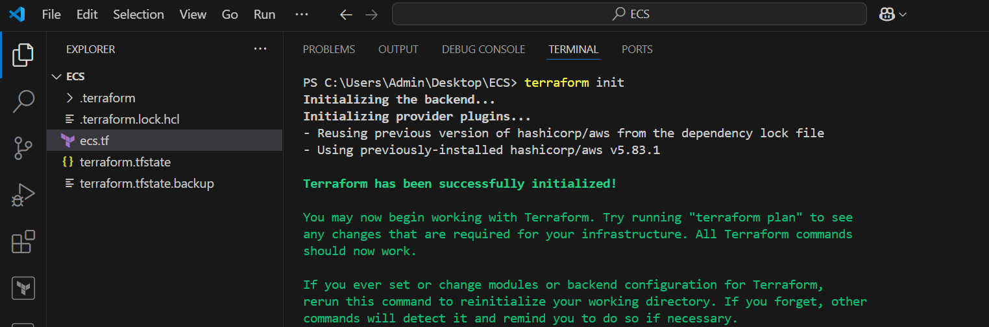
Now run the code in new terminal and configure the code with the aws security credentials and enter the required details like access key id and password, region and format
After configuration enter the command “terraform init” to initialize the code
After successfully initializing enter the command “terraform plan” to creates an execution plan, which lets you preview the changes that Terraform plans to make to your infrastructure

Slide 63
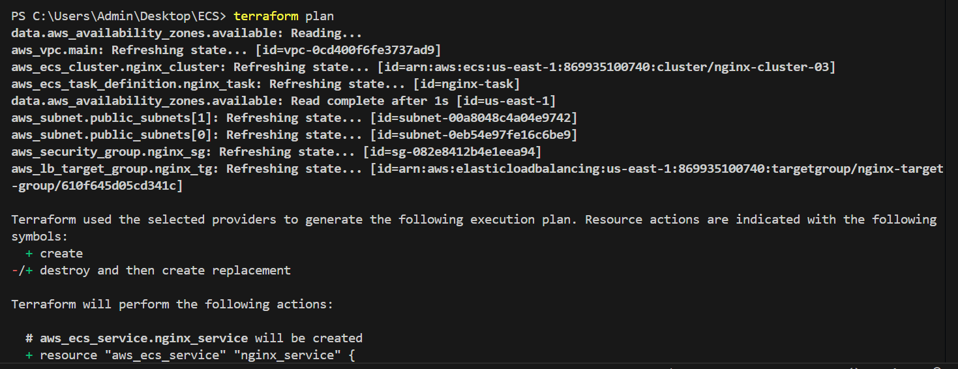
All the Vpc’s, routetables, subnets and internet gateways are get created after applying the plan command
We can check this changes in aws console weather the vpc, subnets…etc are created or not
Ecs cluster and load balancer will be created after successfully applying the terraform plan command
It takes few minutes for cluster to be in the active status

Slide 64
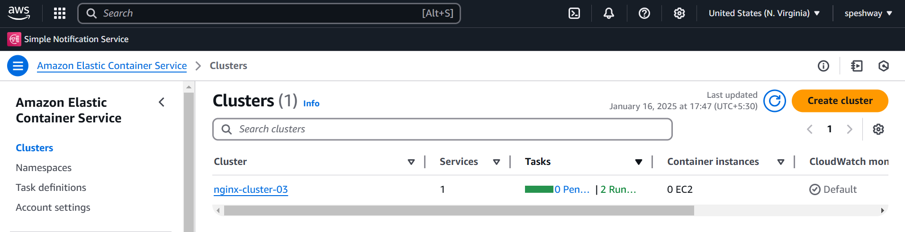
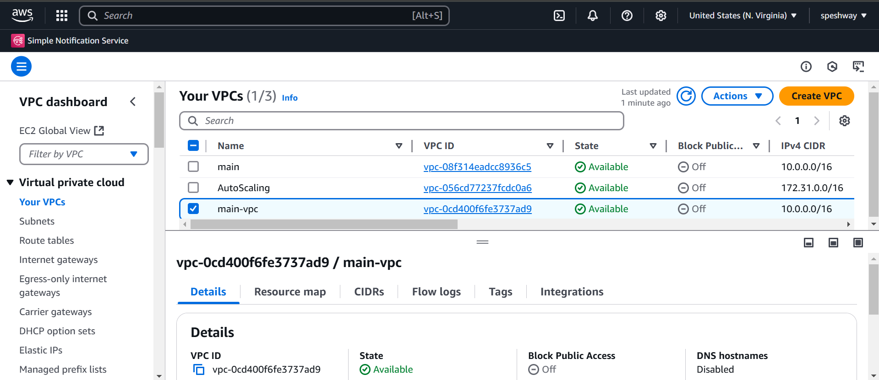

Slide 65
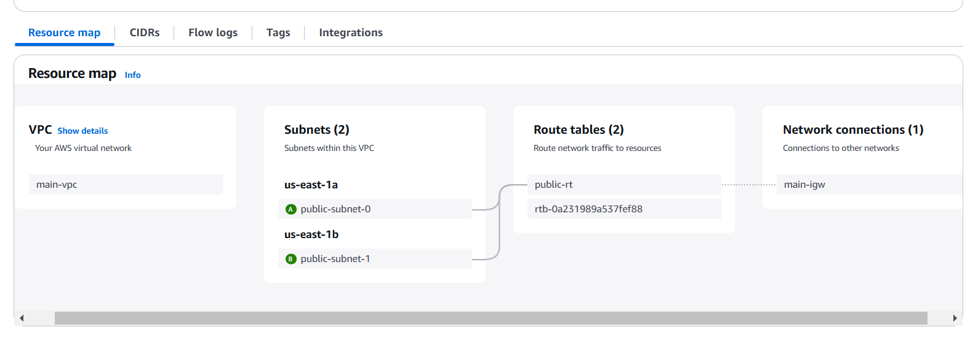
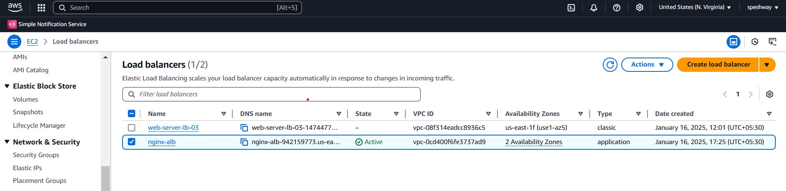

Slide 66
After creating the cluster, vpc and load balancer now enter the command “terraform apply” for executes planned actions, creating, updating, or deleting infrastructure resources to match the new state outlined in your IaC
Now open the aws console and search for load balancer and copy the DNS name of ngnix image

Slide 67
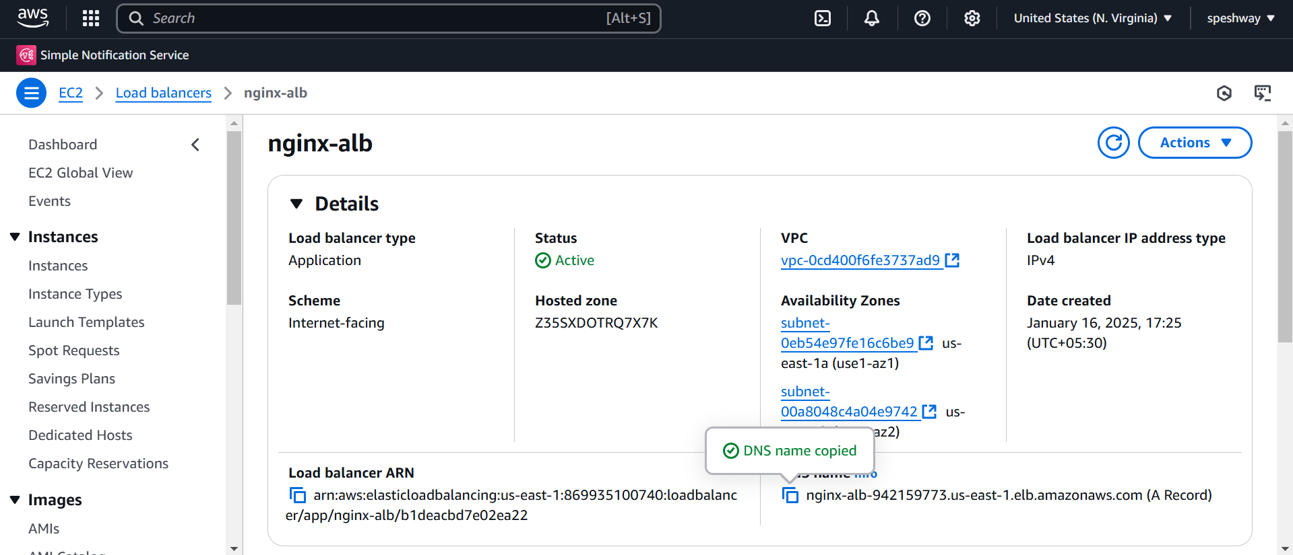
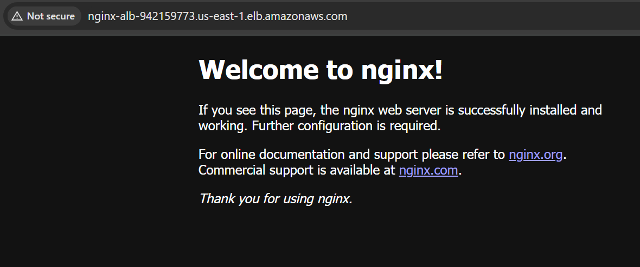
Paste the DNS Link in chrome with port number 80 to access the Nginx image

